Slide 1
GEE LEAF Toobox and GEE LEAF Production Tool
Both tools were developed based on Google Earth Engine APIs.
(2) Different user interface. Graphic User Interface vs a Python dictionary.
(3) Different output spatial unit. GEE LEAF toolbox and GEE LAEF production tool apply LEAF algorithm to a single scene and a mosaic image, respectively.
(4) Different programming languages. LEAF Toolbox and LEAF Production Tool are debveloped using Javascript and python,respectively.
Exporting processes can be fully automated.
Be able to use Google Cloud Service Account so that customized resources can be reserved and utilized.
The status of exporting tasks can be programmingly monitored.
In addition to GEE APIs, regular Python APIs can also be integrated into the development.
Professional IDE (e.g., Visual Studio Code) and Version Control System (e.g., GitHub) can be utilized in software development.

Slide 2
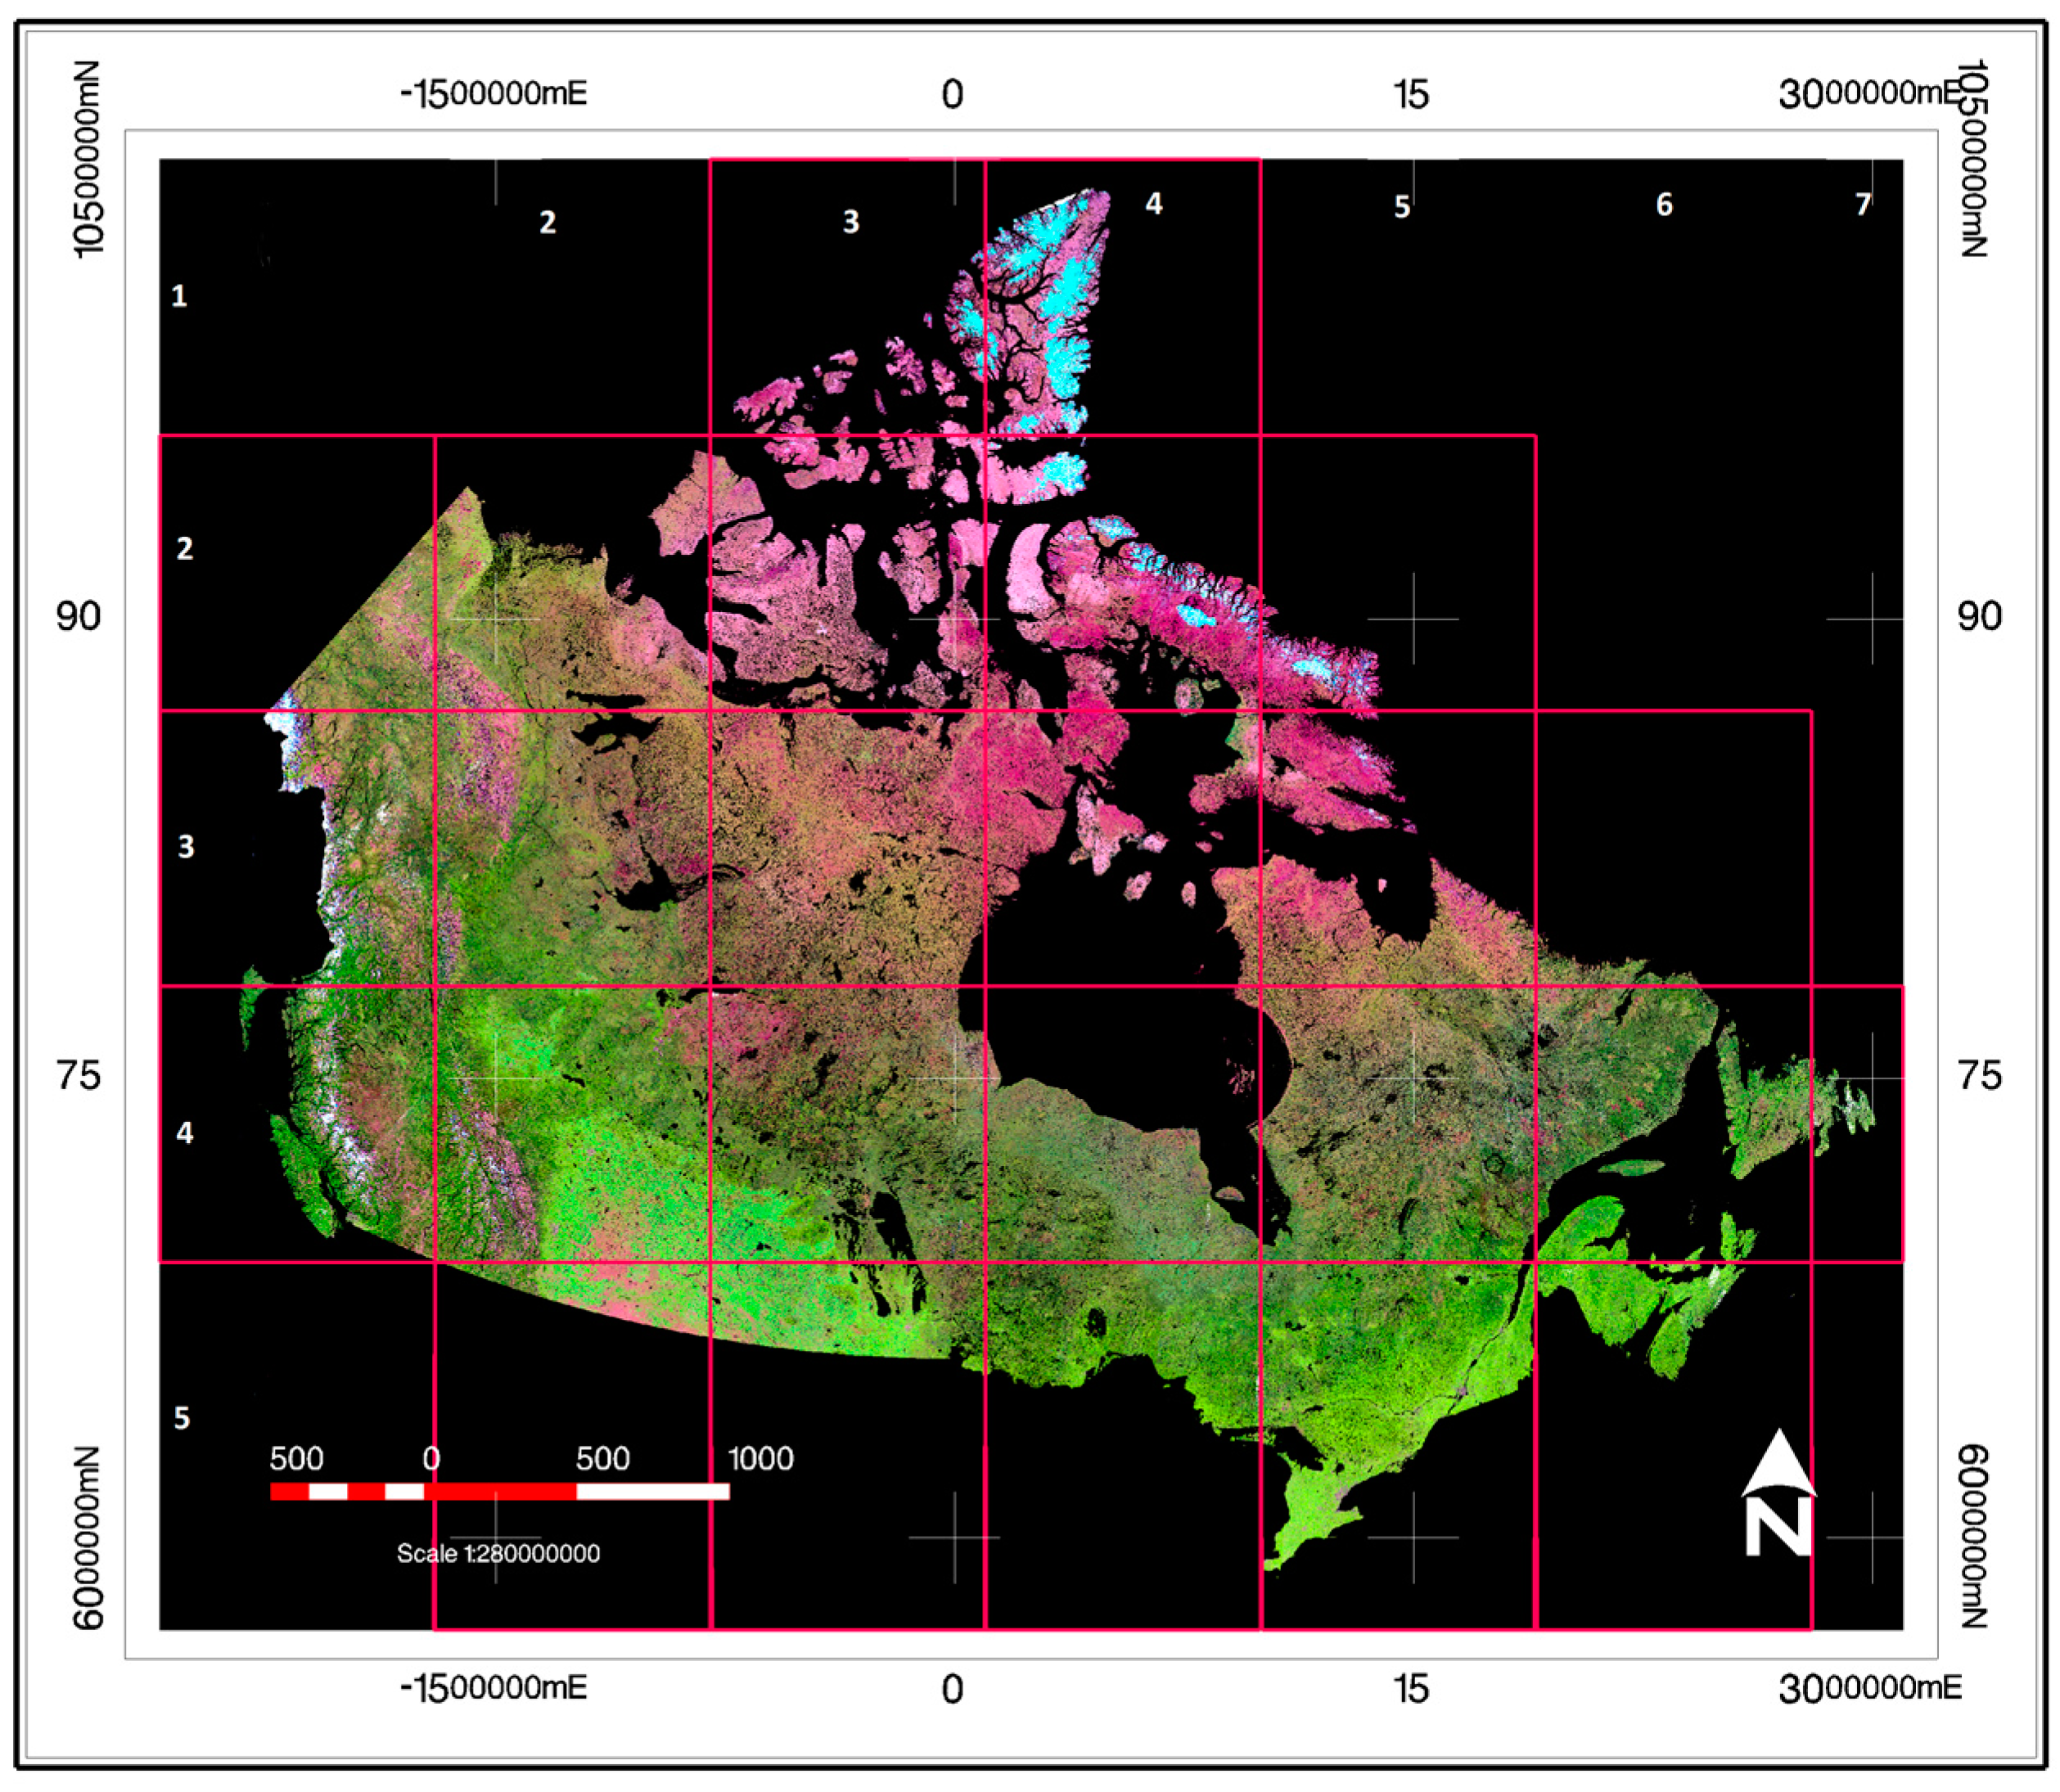
Tile Grid System Used for Production
(1) The Canadian landmass is covered by a total of 26 tiles.
(2) Each tile covers a ground area of 900 x 900 square kilometers.
(3) A product image for a tile at 20m resolution contain 45000x 45000 pixels.
(4) Customized areas can also be specified for a production

Slide 3
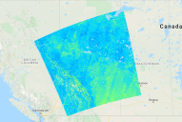
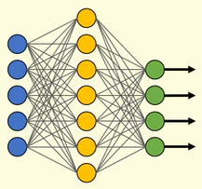
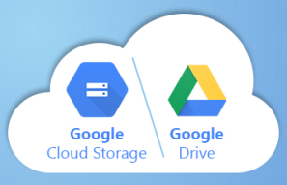
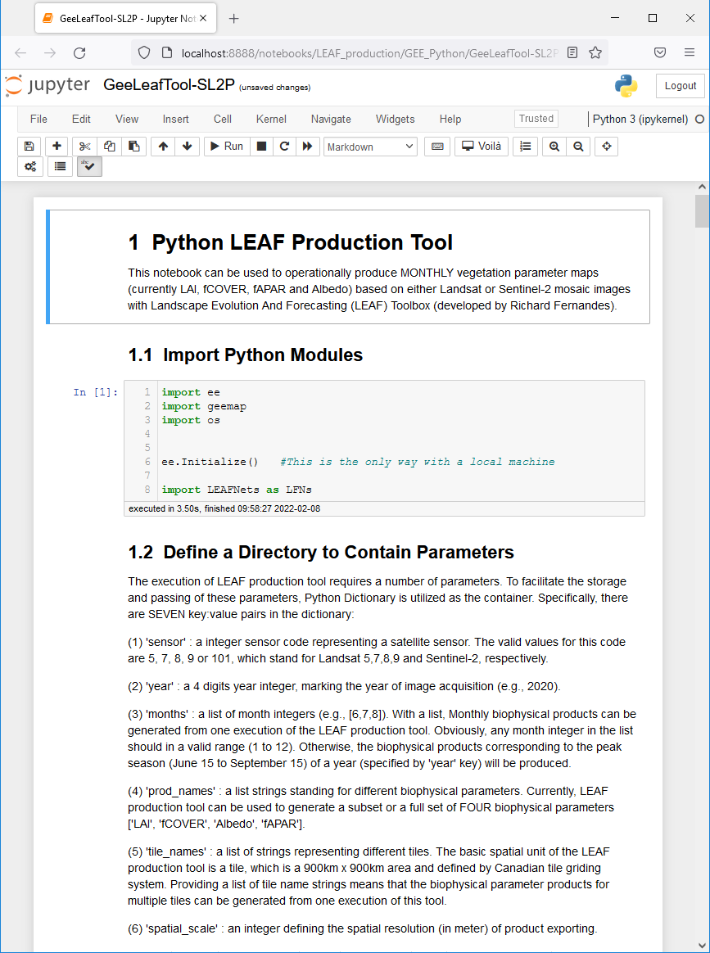
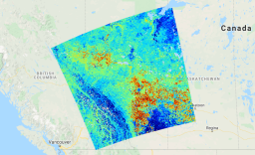
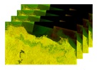
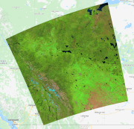
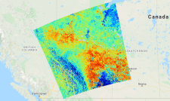

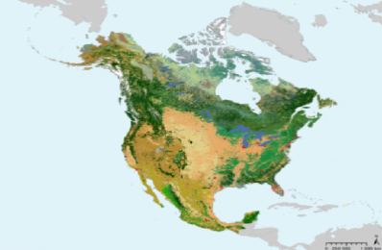
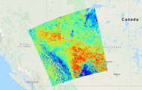
Flowchart of the GEE LEAF Production Tool
Albedo Map
Trained LEAF ANN
LAI Map
GEE Data Catalog
Composited Image
fCOVER Map
Land Cover Map
fAPAR Map
Notes:
GEE LEAF production tool requires three major inputs:
A set of trained neural networks for different land cover types;
a composite/mosaic image covering a specified area
and a national land cover map.
Specifically, different neural networks are applied to the mosaic image according to land cover types.

Slide 4
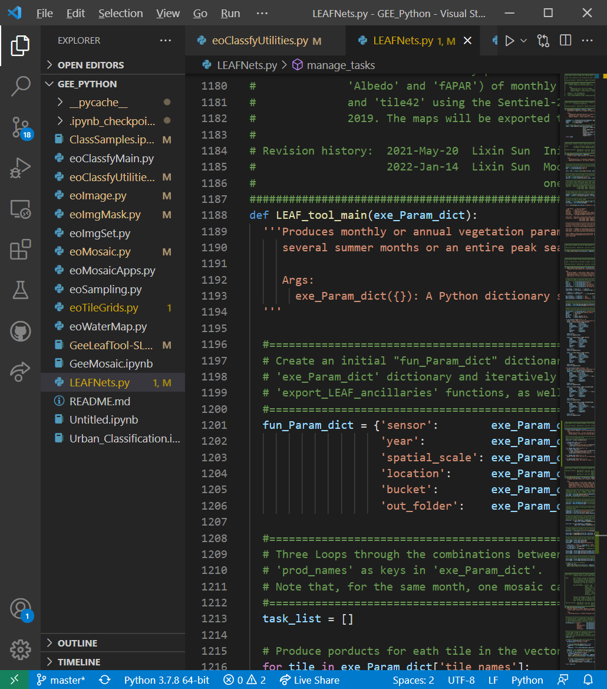
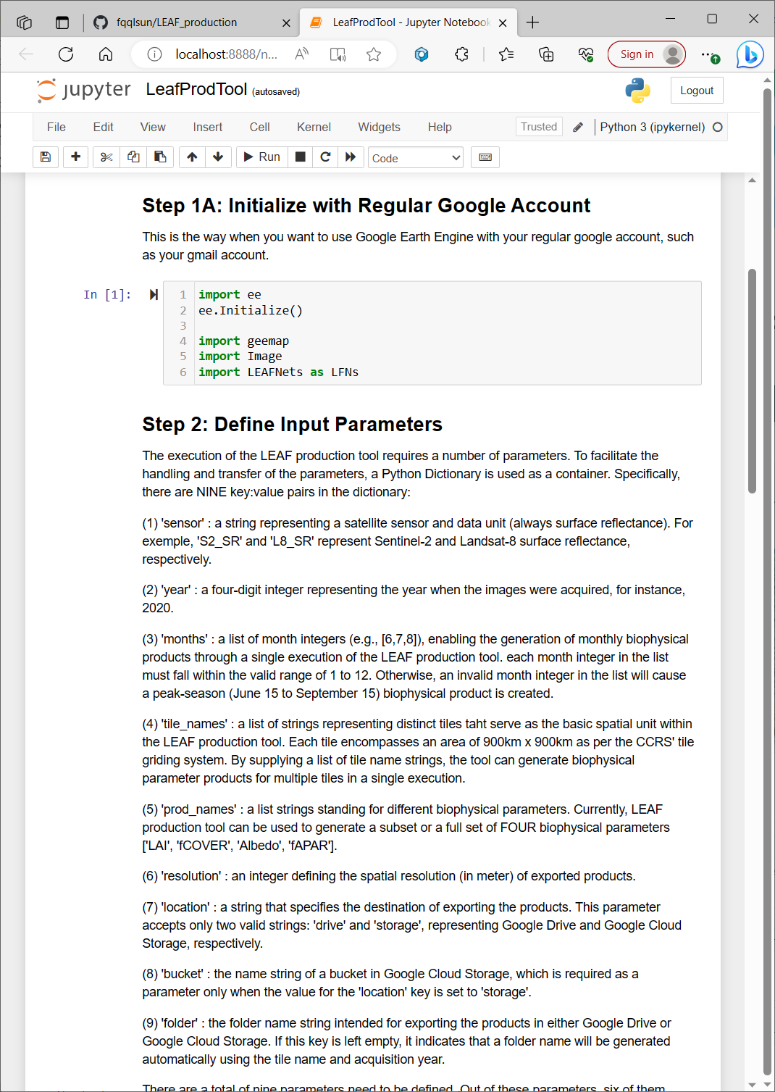
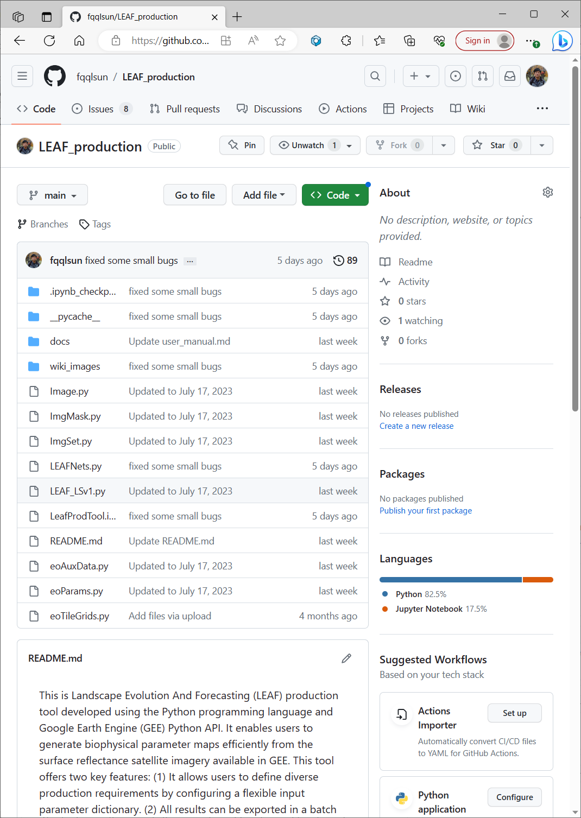
Development Environments of the GEE LEAF Production Tool
Module development with VS Code Execution with Jupyter Notebook Backup with GitHub
Notes:
Generally, three open-source environments/software are involved in the code development for GEE LAEF production tool, and they are Microsoft Visual Studio Code IDE, Anaconda Jupyter Notebook and Github.
All the python modules are developed using VS code. This is the most popular and powerful free programming IDE offered by Microsoft
Jupyter Notebook is used to define required input parameters and execute GEE LEAF production tool.
All the code, related documents/instructions are backuped in a publicly accessible repository on GitHub, .

Slide 5
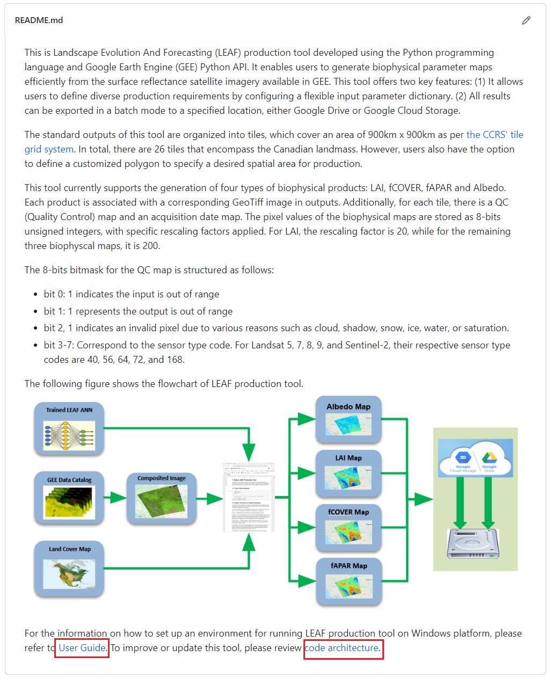
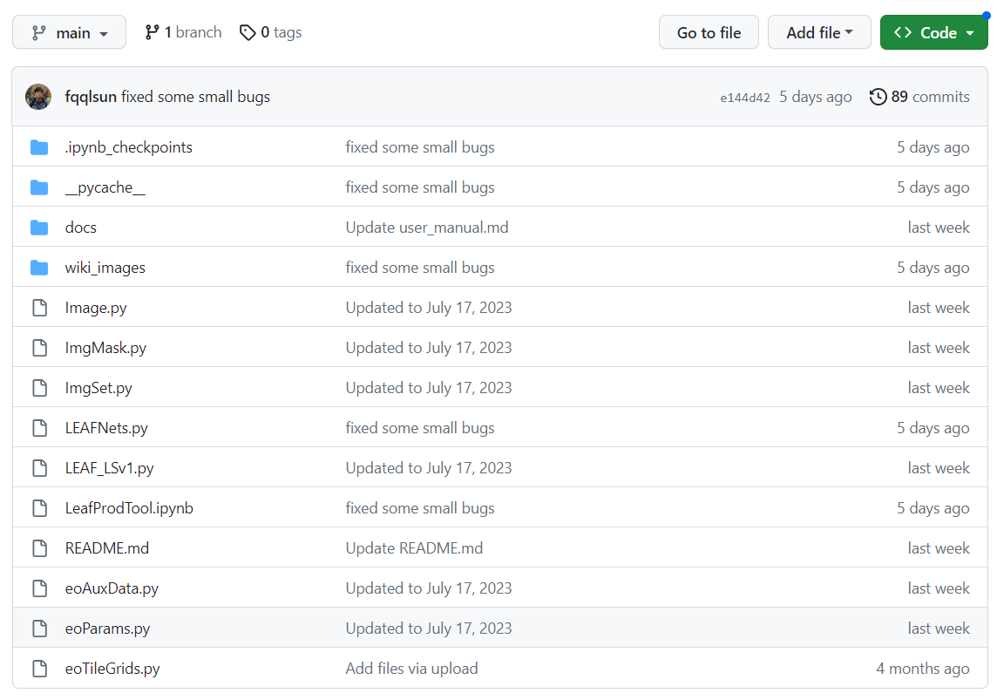
Public GitHub Site of the GEE LEAF Production Tool (https://github.com/fqqlsun/LEAF_production)
Notes:
All the source code and related documents of GEE LEAF production tool are publicly accessible through GitHub
The left side is the directory and files in the GitHub repository of GEE LAEF production tool
The right side is the README file. From this file, users can get most information they need to know. For example, User Guide, code architecture, bitmask structure of QC map and CCRS’ tile grid system map

Slide 6
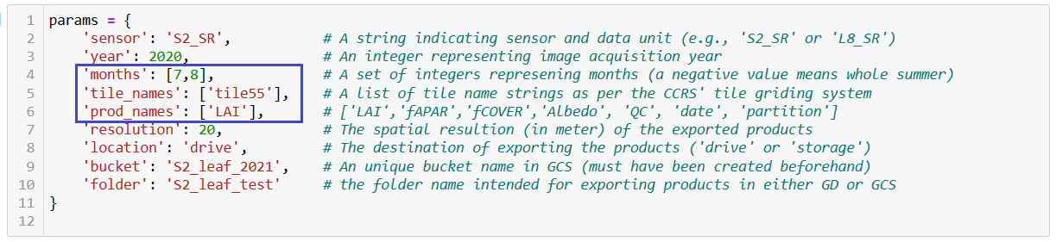
Execution of GEE LEAF Production Tool
The notebook for running the LEAF production tool includes a dictionary that enables users to specify all
the necessary parameters. With this dictionary, the execution of the LEAF production tool becomes
straightforward and highly flexible.
There are three parameters (marked with blue box) accept lists of values. By using different combinations of the three lists, various production scenarios can be implemented.
For instance:
‘months’: [5,6,7,8,9,10], ‘tile_names’: [‘tile55’], ‘prod_names’: [‘LAI’, ‘fAPAR’, ‘fCOVER’]
‘months’: [5,6,7,8,9,10], ‘tile_names’: [‘tile35’,‘tile55’,’tile44’], ‘prod_names’: [‘LAI’]

Slide 7
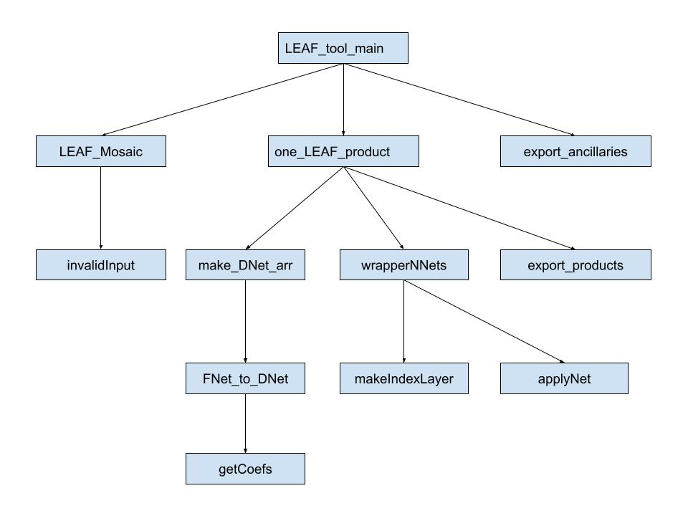
Function Call Graph of Python LEAF Production Tool

Slide 8
LEAF Production Statistics (1)
(1) The production efficiency of LEAF is directly proportional to the number of reserved exporting slots.
(2) When 10 exporting slots are reserved (the case of using Google Service Account), it takes approximately 175 and 40 hours to generate one year of national 20m and 100m resolution monthly (May to Oct.) LEAF tile products (LAI, fCOVER, fAPAR and Albedo) using Sentinel-2 data. If 5 exporting slots are reserved (the case of regular Google account), these time requirements will double.
(3) The data volumes of one year national 20m and 100m resolution monthly (May to Oct.) LEAF tile products using Sentinel-2 data are roughly 850 and 45 GB, respectively.

Slide 9
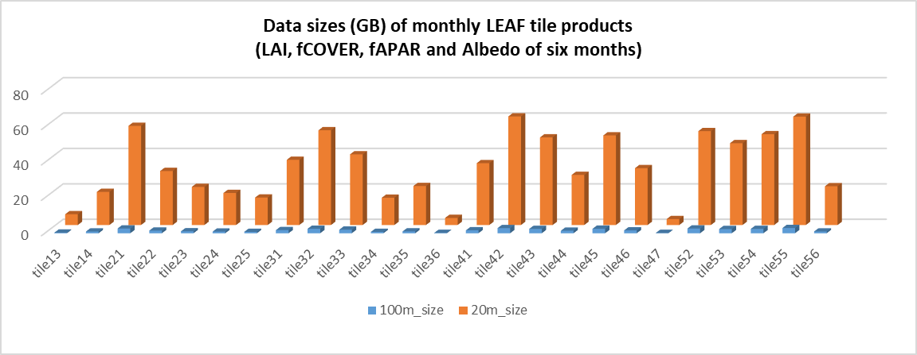
LEAF Production Statistics (2)

Slide 10
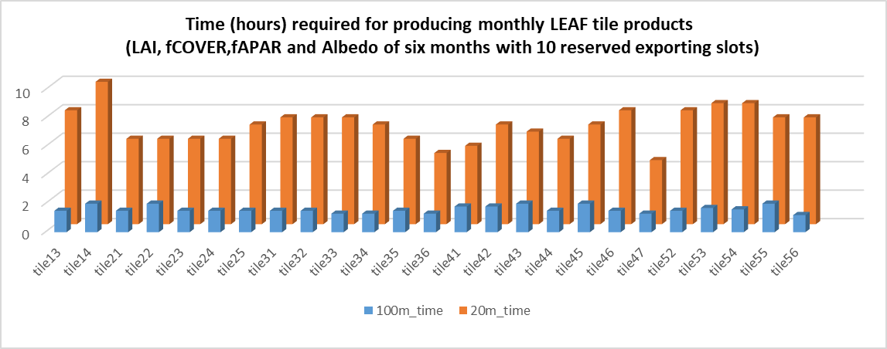
LEAF Production Statistics (3)

Slide 11
Image Format and Exporting Options
The results of GEE LEAF production tool are compressed GeoTIFF images with small overlap between tiles. Each tile covers a ground area of 900 x 900 square kilometers.
There are 7 images (4 estimated parameter images, 1 land cover map, 1 acquisition time map and 1 quality contral map) associated with one monthly LEAF tile product.
The results of LEAF production tool can be exported directly to either Google Drive (GD) or Google Cloud Storage (GCS) at a specified spatial resolution.
The images exported to GD and GCS can be downloaded to local drive through synchronized drive and “gsutil” command, respectively.

Slide 12
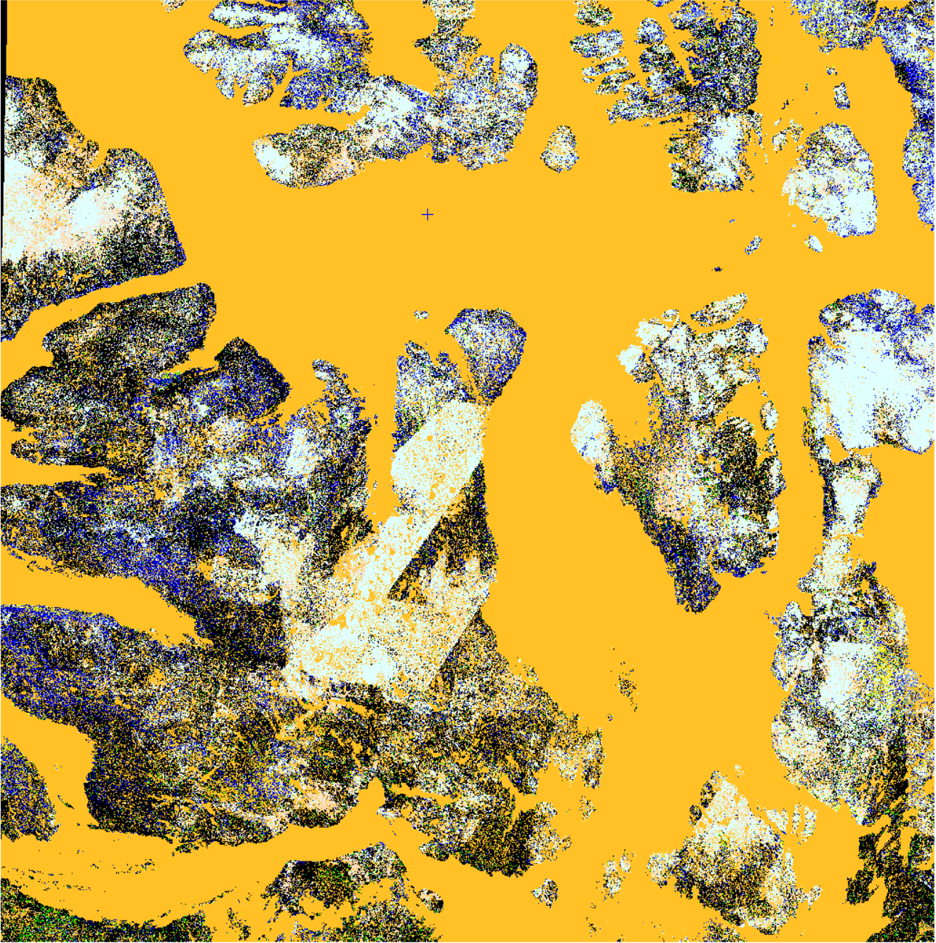
Quality Control Layer in Products
The 8-bits bitmask for the QC layer is structured as follows:
bit 0: 1 indicates the input is out of range
bit 1: 1 represents the output is out of range
bit 2, 1 indicates an invalid pixel due to various reasons such as cloud, shadow, snow, ice, water, or saturation.
bit 3-7: Correspond to the sensor type code. For Landsat 5, 7, 8, 9, and Sentinel-2, their respective sensor type codes are 40, 56, 64, 72, and 168.

Slide 13
Data Access
Datacube: https://datacube.services.geo.ca/en/viewer/eo4ce/vegetation/monthly-vegetation.html
STAC Catalog – see next slide
OpenGov.ca: https://open.canada.ca/data/en/dataset/37745ea7-d0cf-4ef6-b6b8-1cb3a7fce0b8
Science Data Hub (until October, 2023; ask richard.fernandes@nrcan-rncan.gc.ca for access): SSC Datahub - CCRS (canada.ca)

Slide 14
STAC Catalog Access
collection endpoint for the Monthly Vegetation Parameters: https://datacube.services.geo.ca/api/collections/monthly-vegetation-parameters-20m-v1
list all the items available under this collection from this link: https://datacube.services.geo.ca/api/collections/monthly-vegetation-parameters-20m-v1/items (24 items)
Or perform spatial/temporal searches using queries such as the following:
https://datacube.services.geo.ca/api/search?collections=monthly-vegetation-parameters-20m-v1 (entire collection – 24 items)
https://datacube.services.geo.ca/api/search?collections=monthly-vegetation-parameters-20m-v1&datetime=2019-01-01T00:00:00Z/2019-12-31T00:00:00Z (Year 2019 – 6 items)

